Slide 1

AI for Diabetes: Can We Predict the Future?
An Interactive Machine Learning Application for Diabetes Prediction
Group 10: Shadi Alfaraj, Sebastian de Wind Pesantes, Alex Karam, Thomas Mann, Uxia Lojo Miranda, Sarina Ratnabhas

Slide 2





Why Does Diabetes Prediction Matter?
What is Diabetes?
Diabetes is a disease that occurs when one’s blood glucose levels are too high due to the body’s inability to use or produce insulin effectively.
Importance of Diabetes Prediction
The early prediction of diabetes is crucial in ensuring interventions are implemented to prevent health complications. Delaying detection can increase risk of nerve damage and cardiovascular disease.
.
537 Million adults worldwide
$966 billion Annual Cost
Likely Preventable
50% of diabetes cases remain undiagnosed

Slide 3
Machine Learning Project Phase
Phase
0
Phase
1
Phase
2
Phase
3
Phase
4
Phase
5
Phase
6
ML
Applicability
Extract Data
Exploratory Data Analysis
Data Preparation
Model Training
Model Evaluation
Model Deployment

Slide 4
Phase 0 – Machine Learning Applicability
Early Diagnosis & Risk Assessment:
ML models analyze medical data to predict diabetes risk before symptoms appear.
Help in proactive health management and lifestyle modifications.
Benefits:
Faster and more accurate than traditional diagnostic methods.
Reduce healthcare costs by preventing complications.
Challenges & Considerations:
Data quality, bias in training datasets, privacy concerns.
Need for model explainability in medical decisions.

Slide 5
Phase 1 – Extract Data
The Pima Indians (Native American) Diabetes Dataset
Total Samples: 768 women (ages 21–81)
Number of Features: 8 medical predictors + 1 outcome variable
Outcome Variable: Binary classification (0 = No Diabetes, 1 = Diabetes)
Diabetes Prevalence in Dataset: 268 out of 768 (34.9%) have diabetes
Imbalanced Data: 65% non-diabetic, 35% diabetic

Slide 6
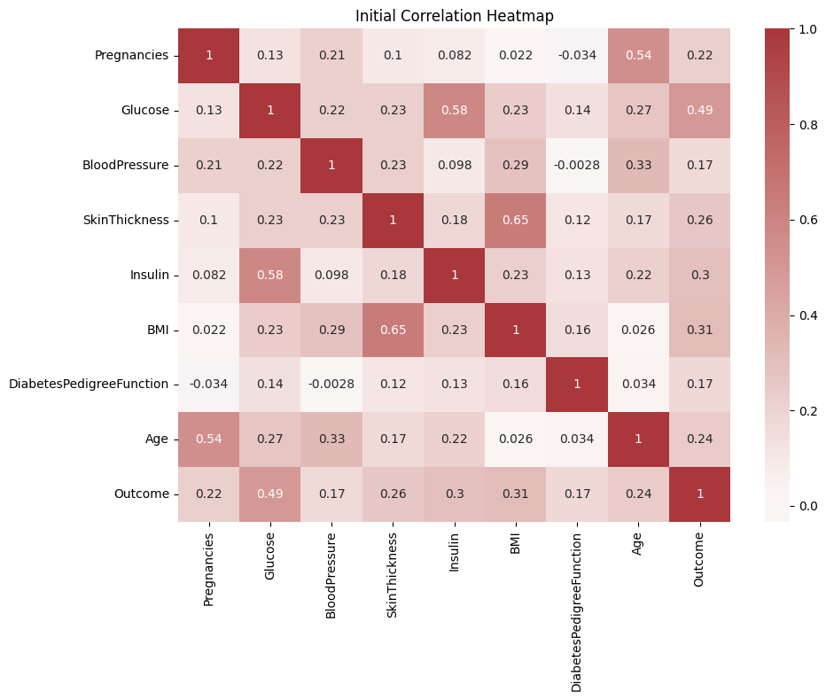
Phase 2 – Exploratory Data Analysis
Correlation: Heatmap
The strongest observed correlation relating to Outcome is with Glucose.
Moderated observed correlations relating to Outcome are BMI, Insulin and Skin Thickness.

Slide 7
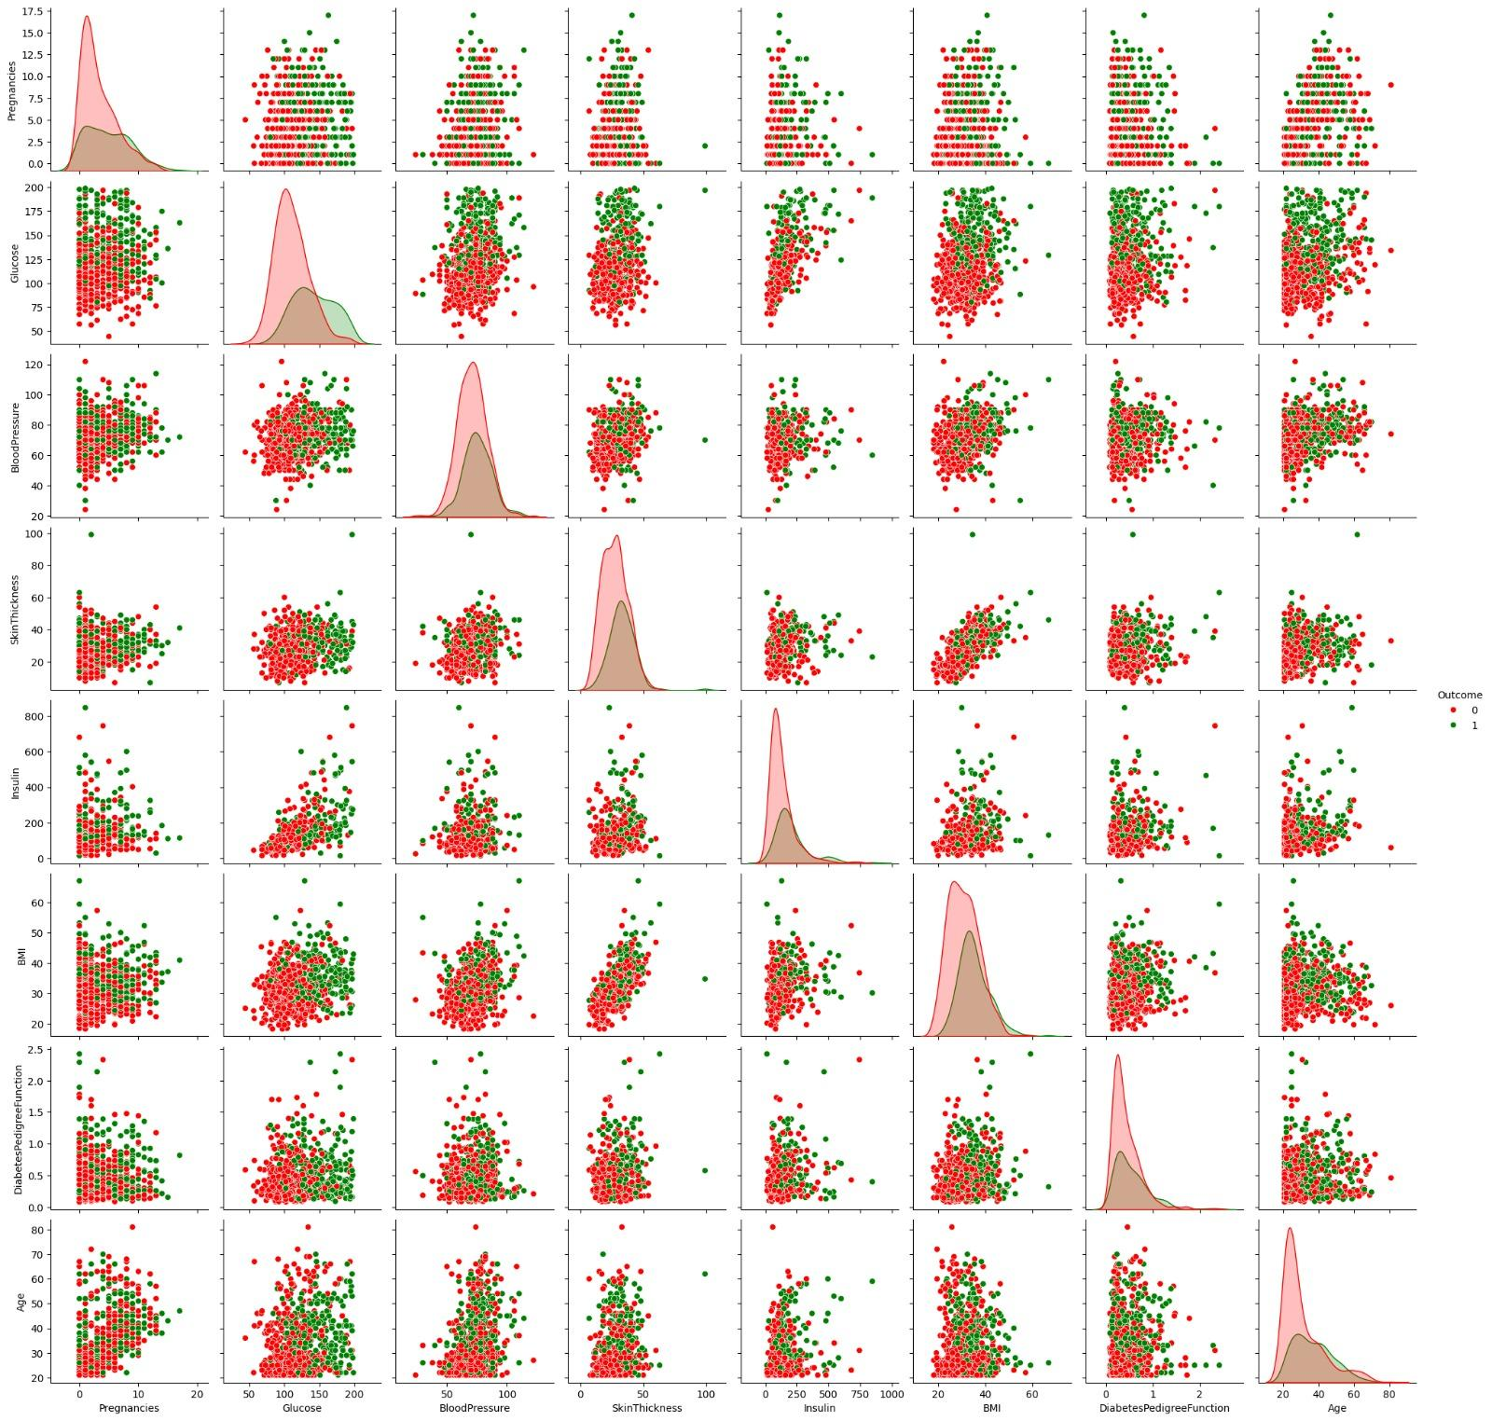
Phase 2 – Exploratory Data Analysis
Scatterplot: Pairplot
Glucose vs. Outcome:
Diabetic patients (green) tend to have higher glucose levels, confirming its correlation with diabetes.
Other Features:
Features like Insulin and Diabetes Pedigree Function show variations but less clear separations between classes.
Machine learning allows us to identify patterns that are unrecognizable for humans.

Slide 8
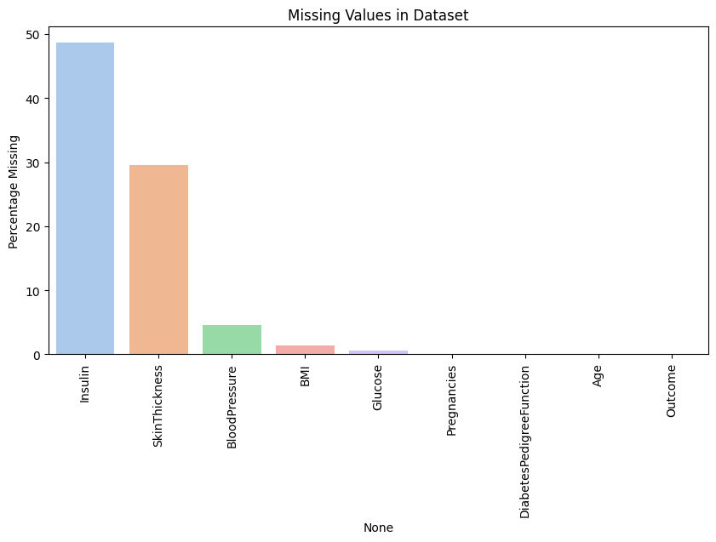
Phase 3 – Data Preparation
Percentage of Null Values
Both Insulin and Skin Thickness exceeded the ~30% threshold for missing values
Removing rows with missing values would leave less than half the dataset remaining
The features exceeding this threshold were dropped

Slide 9
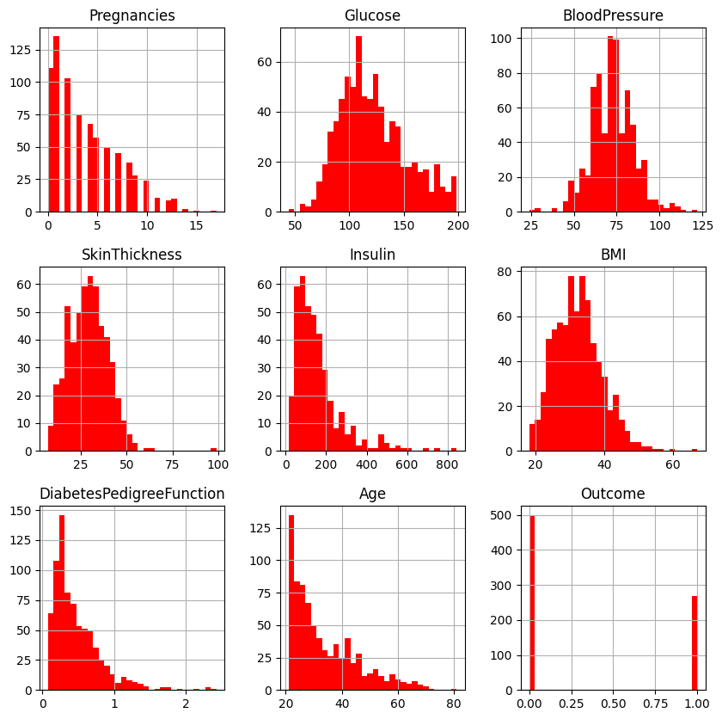
Phase 3 – Data Preparation
Histograms: Distribution of each feature
Observed non-normal distributions in features like Skin Thickness, Insulin and BMI, Diabetes Pedigree Function which were right-skewed
Nulls were imputed with median for Glucose, BMI and Blood Pressure as there were only a few values
The median is more robust to outliers and maintains the central tendency of the data

Slide 10
Phase 4 – Model Training
Fitting logistic regression model
Output is binary (diabetic / not diabetic) - logistic regression is the best fit for this application
Train test split
70-30%
Scaling Data
Used StandardScaler to ensure uniform feature ranges
Fit_transform() for training data
Transform() for testing data

Slide 11
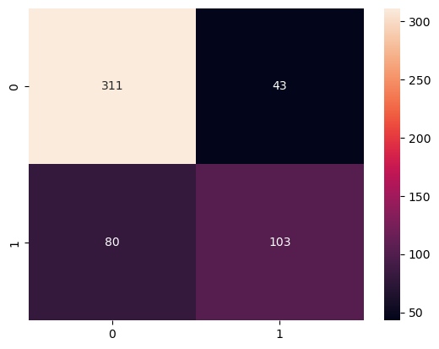
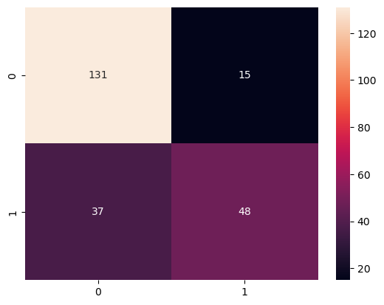
Phase 5 – Model Evaluation
Confusion Matrix (Training)
Confusion Matrix (Testing)

Slide 12
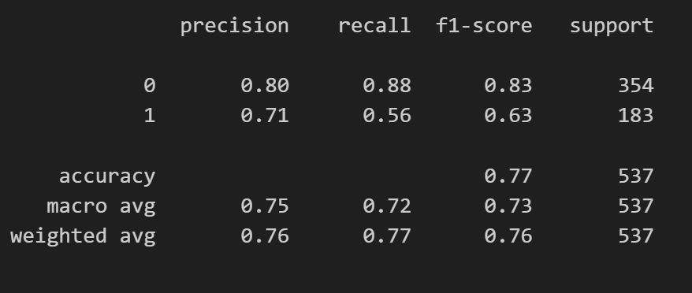
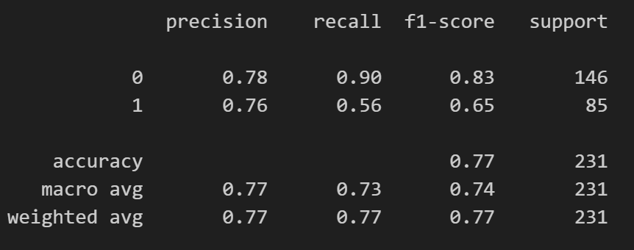
Phase 5 – Model Evaluation
Classification Report (Training)
Classification Report (Testing)

Slide 13
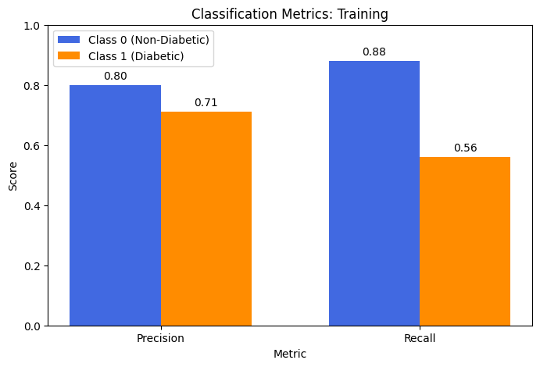
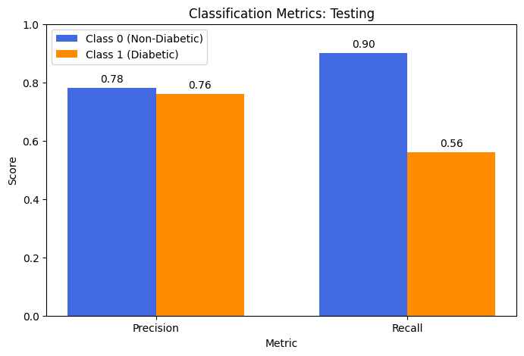
Phase 5 – Model Evaluation
Classification Report Summary
High recall = fewer false negatives
Very conservative in predicting diabetes
Precision: ~77%
Recall for class 1 (0.56): correctly identifies only 56% of diabetic cases
Recall for class 0 (0.89): it is much better at ruling out diabetes than detecting it

Slide 14
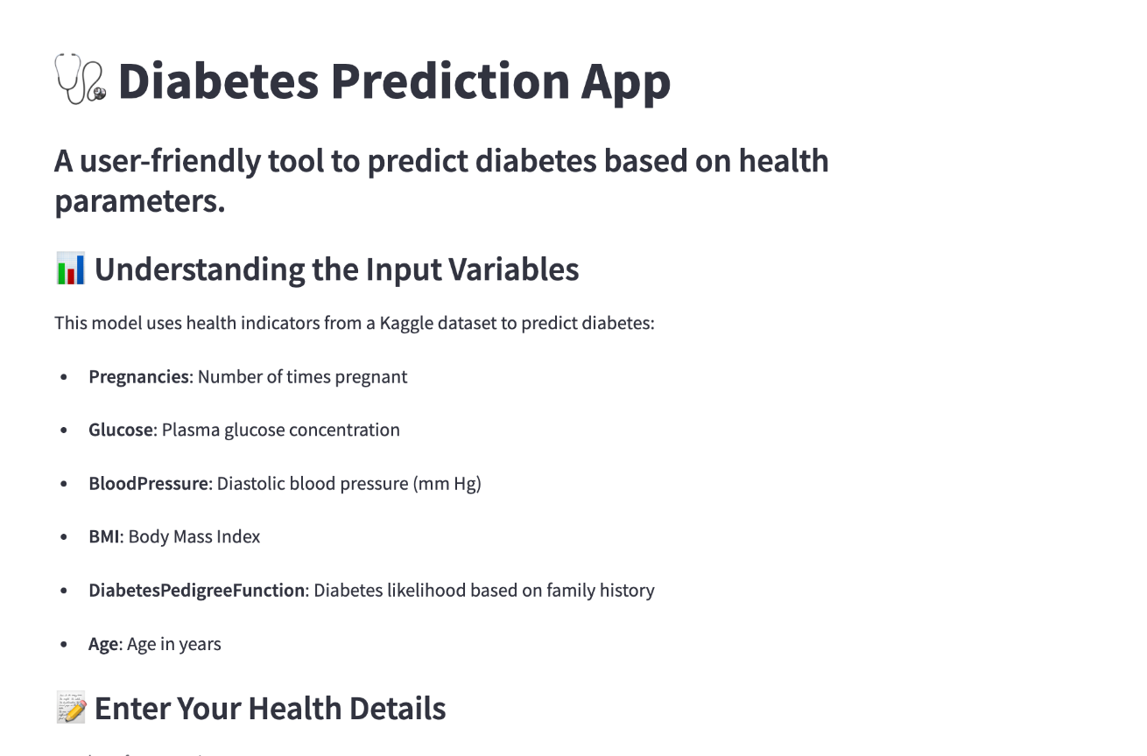
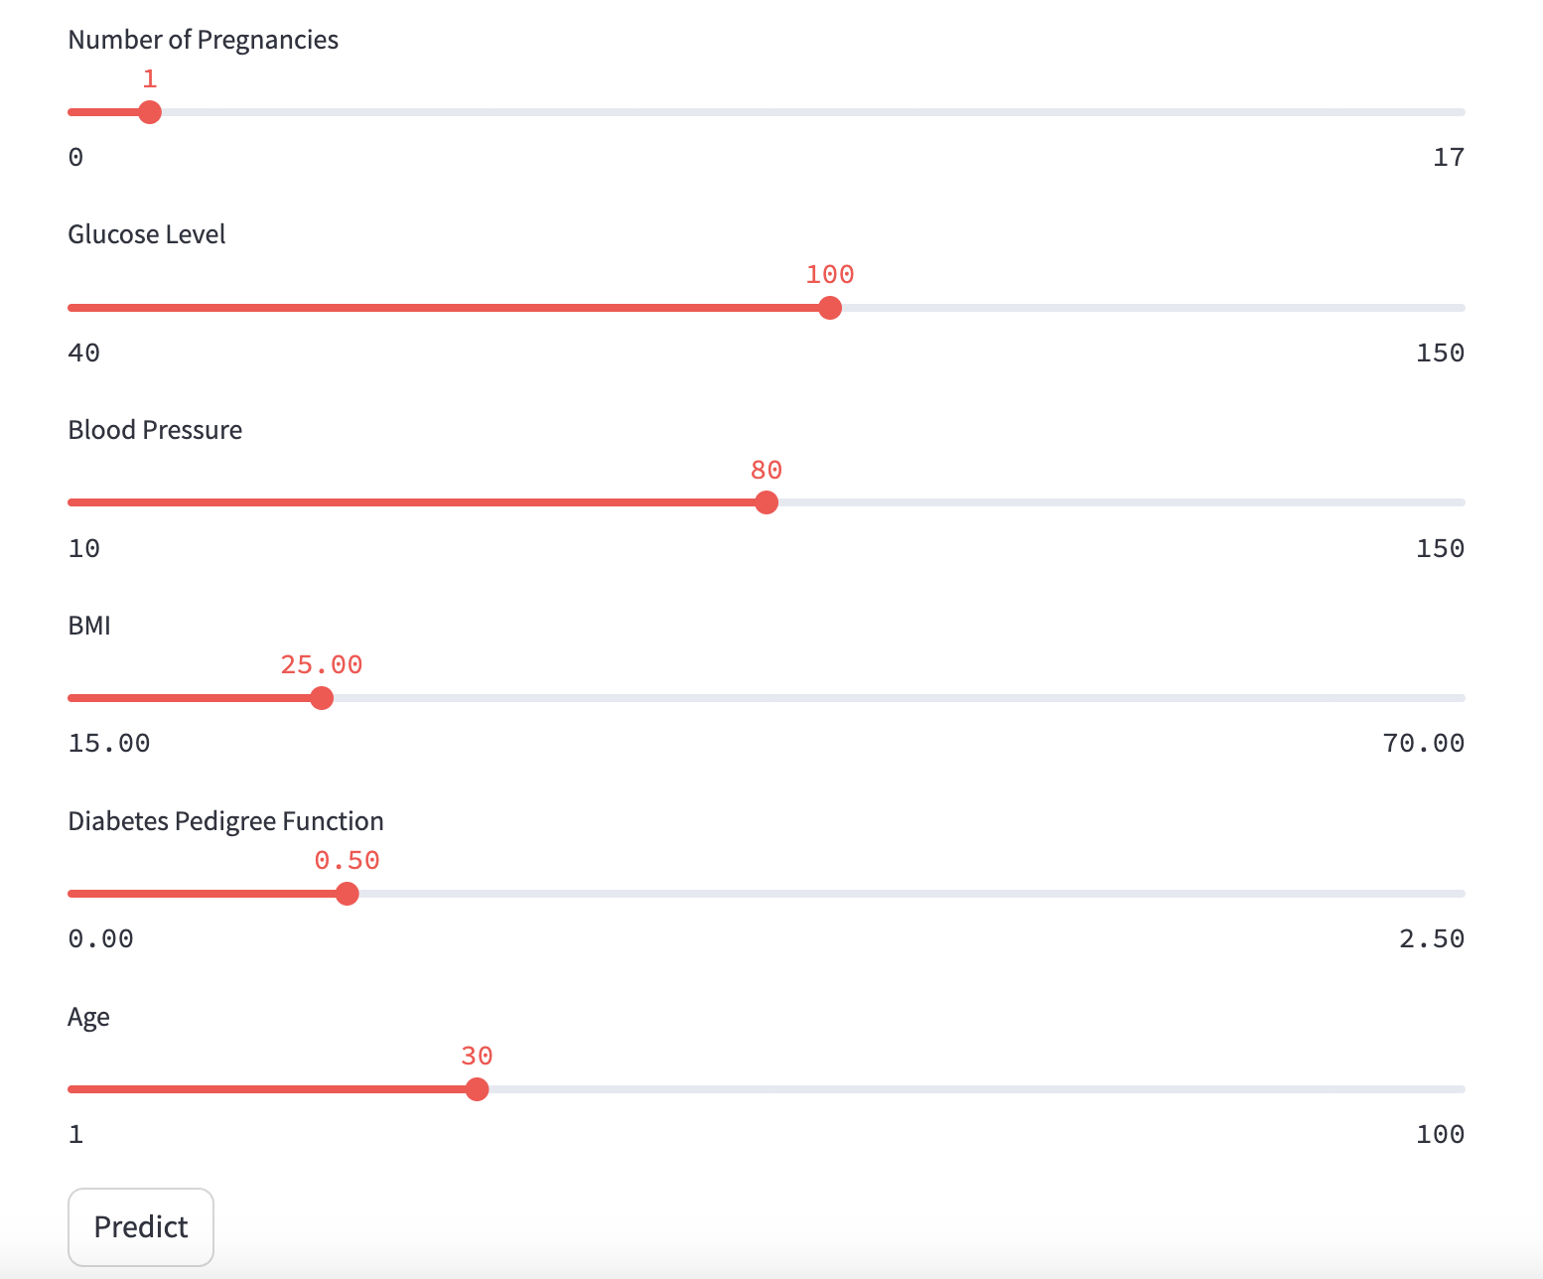
Phase 6 – Model Deployment
Steps:
Extracted model and scalar function through pickle files
Uploaded app python file to streamlit
Adjusted our parameters to mimic real-life scales
Link to App
https://testgroupproject-z3kbnoyifrgazp5rrjksaa.streamlit.app/

Slide 15
Conclusion
Limitations of the Model:
Dataset size (768 subjects) is not large enough to build a comprehensive predictive model
Dataset is very specific to Pima Indian women, not representative of other demographics
Future Improvements:
Increase sample size and diversity across other demographics
L1 Regularization (Lasso) – Helps prevent overfitting and identifies the most important features by shrinking irrelevant coefficients to zero.

Slide 16
THANK YOU :)

